Slide 1
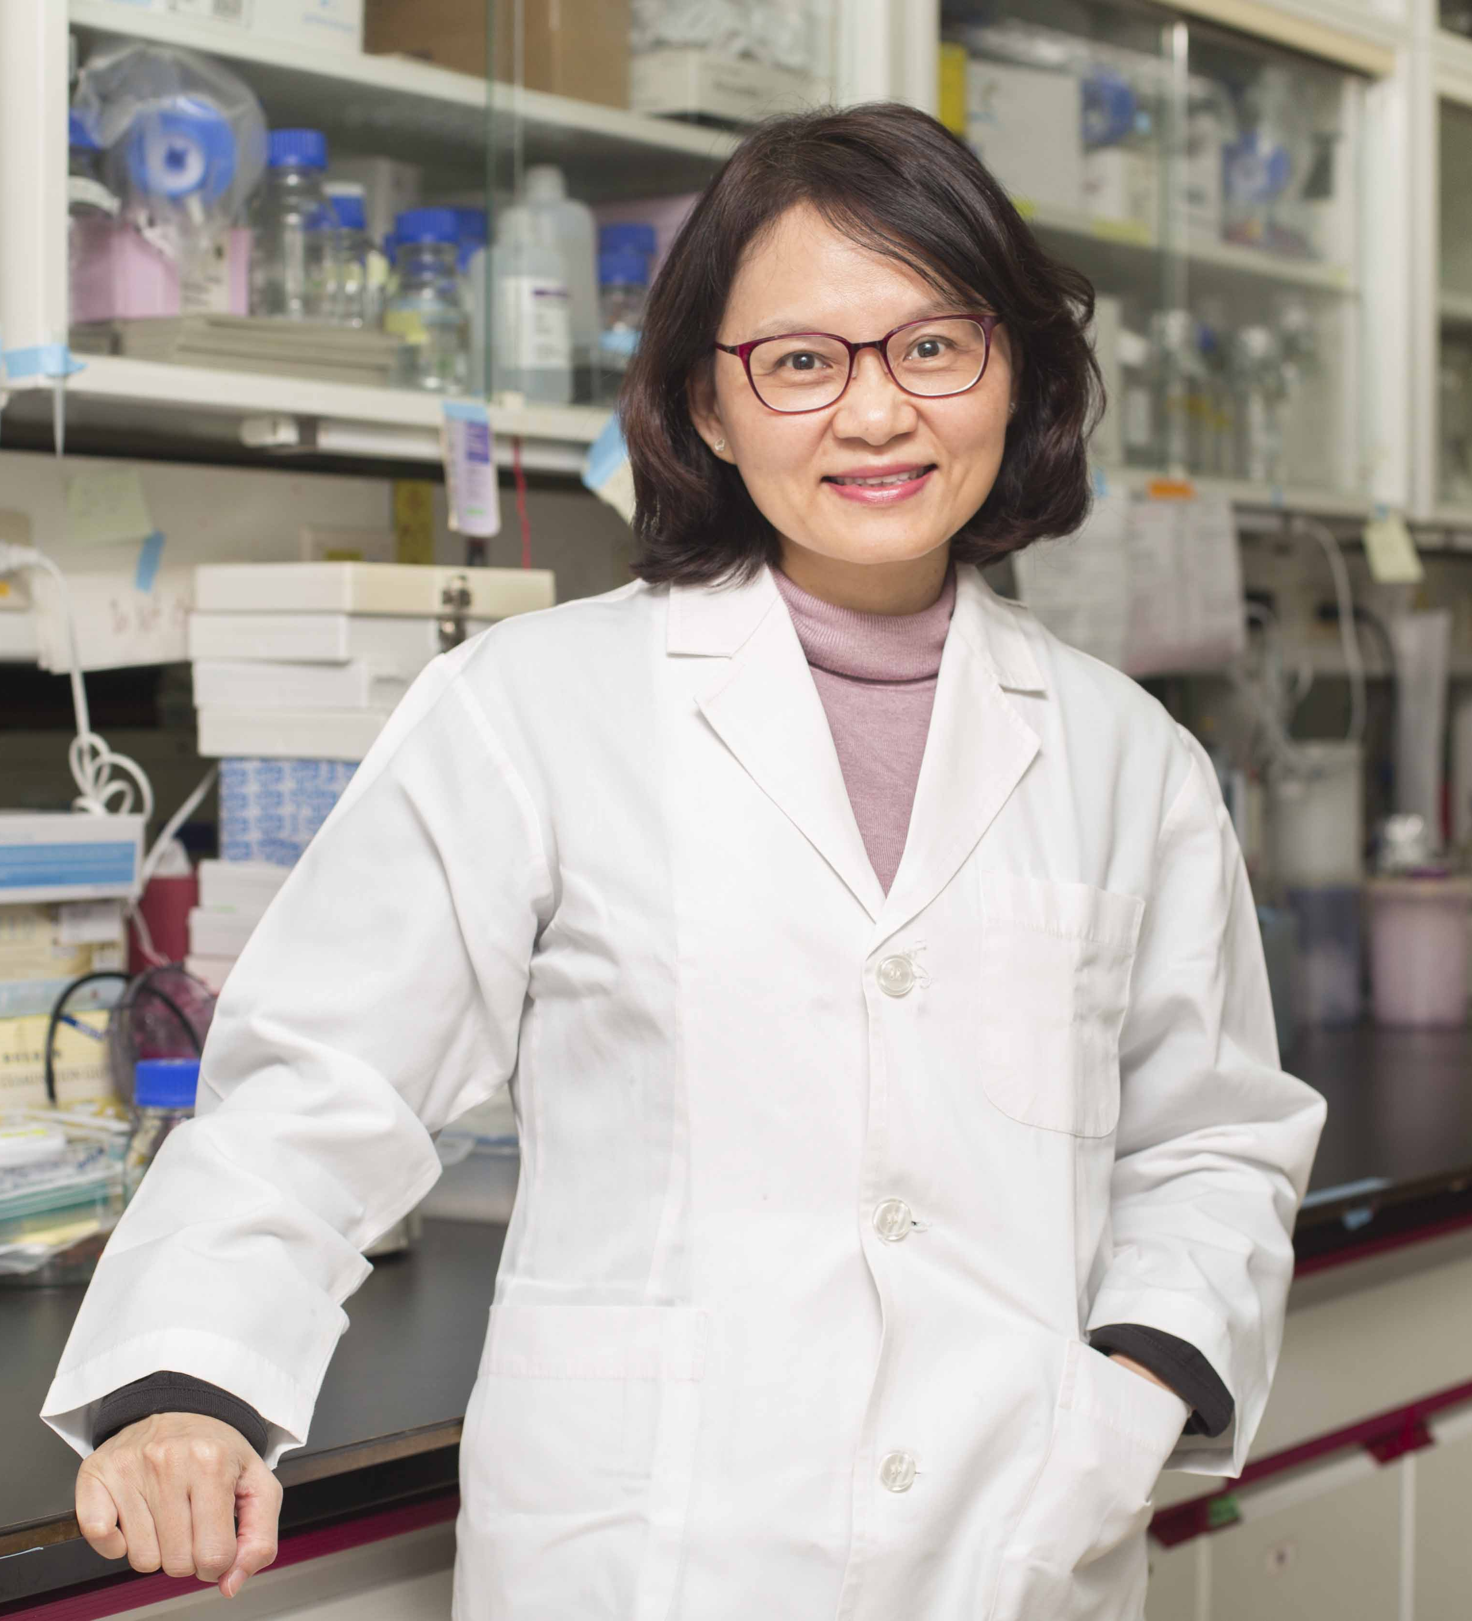
A New Paradigm for Future Medicine Development from Medicinal Plants for Inflammation-related Disease
Special Lecture
Dr. Lie-Fen Shyur
(徐麗芬特聘研究員)
Distinguished research fellow, Agricultural Biotechnology Research Center, Academia Sinica
中央研究院農業生物科技研究中心
Research Focus :
Anti-inflammatory medicinal plants and phytocompounds for cancer prevention and metabolomics study
Protein engineering of enzymes for agricultural biotech applications
Time:
Thursday, May 28, 2020, 2:00-3:30 PM
Location:
Room B201, Tzu Chi University (慈濟大學B201階梯教室)
Host:
Prof. Rong- Kung Tsai/Director/ Institute of Medical Sciences,
Tzu Chi University (蔡榮坤教授/慈濟大學醫學科學研究所)
Open to the public – all are welcome!
醫學科學研究所
Institute of Medical Sciences
TEL: (03)8565301 Ext.2011

